Slide 1
Fin-A-Lytics
Aniruddha Mukherjee
KIIT
Team: Data Crunchers

Slide 2
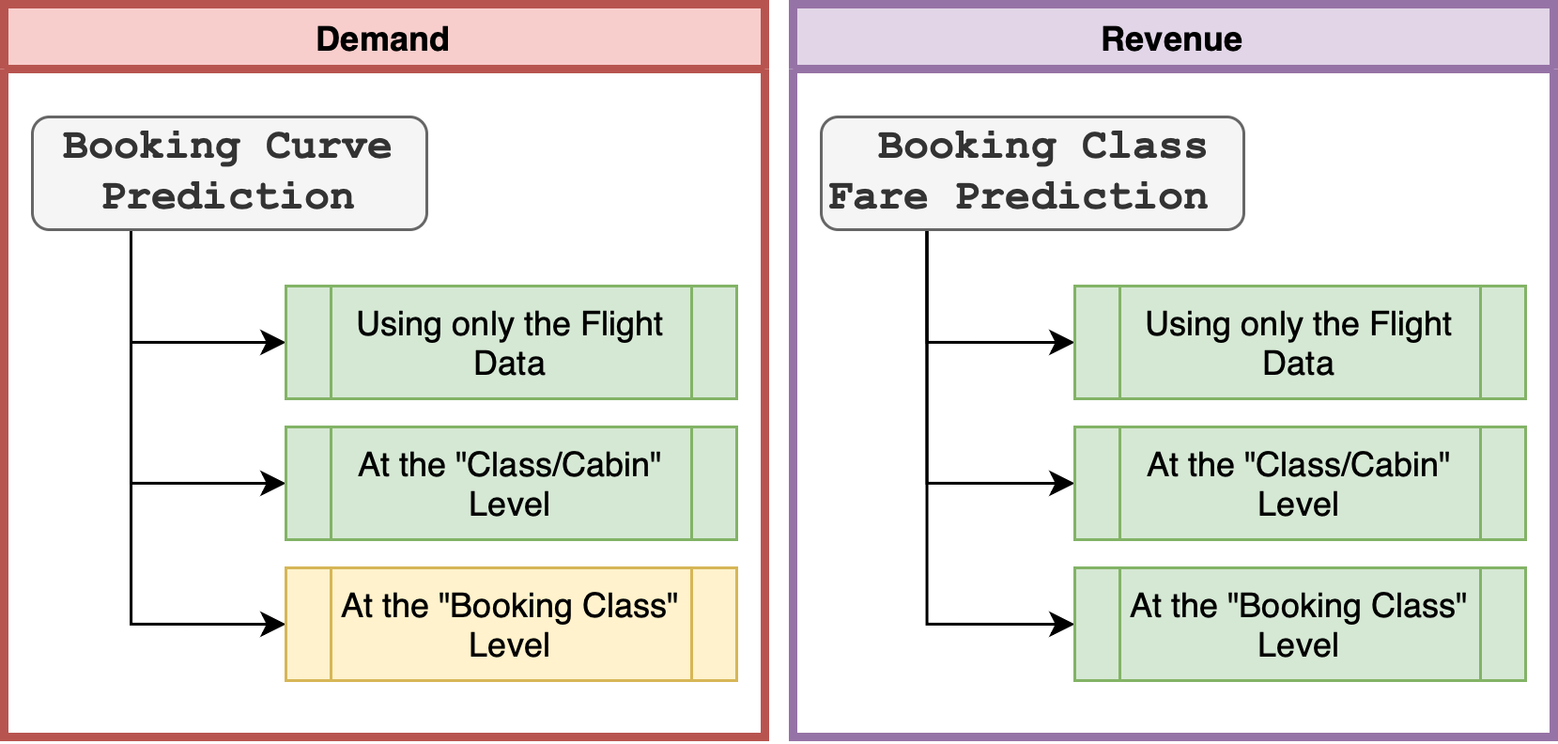

Slide 3


Slide 4
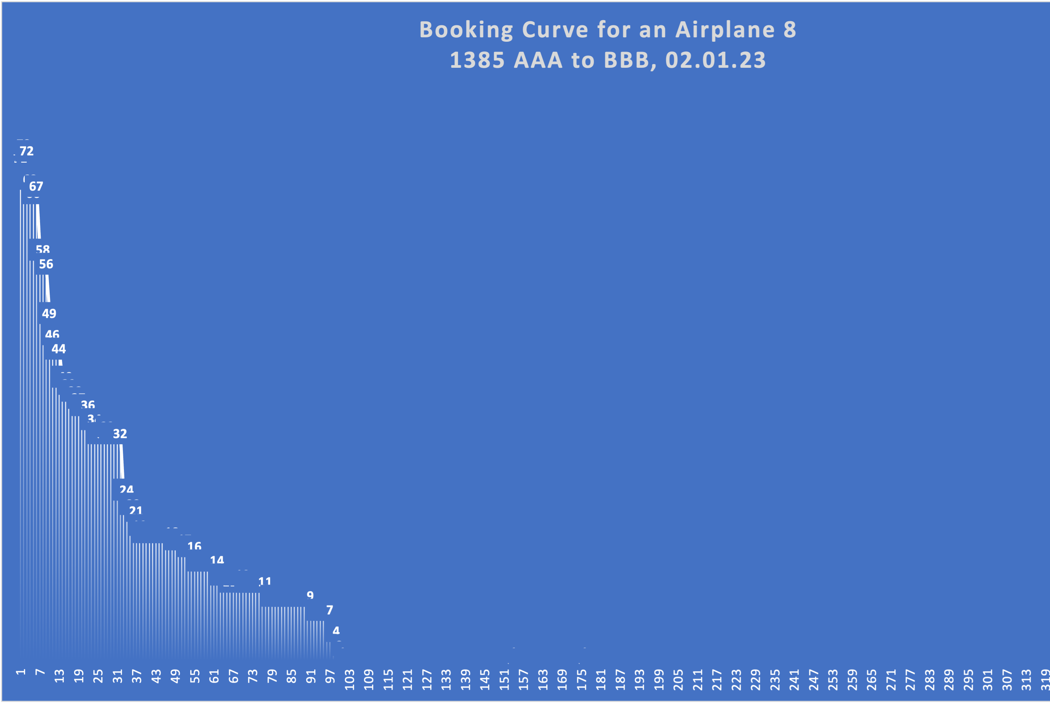
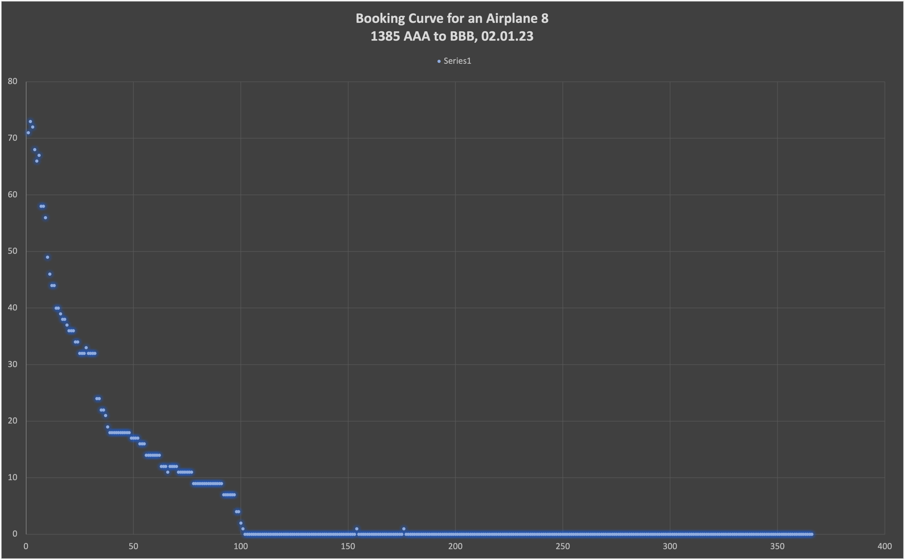
Booking Curves

Slide 5
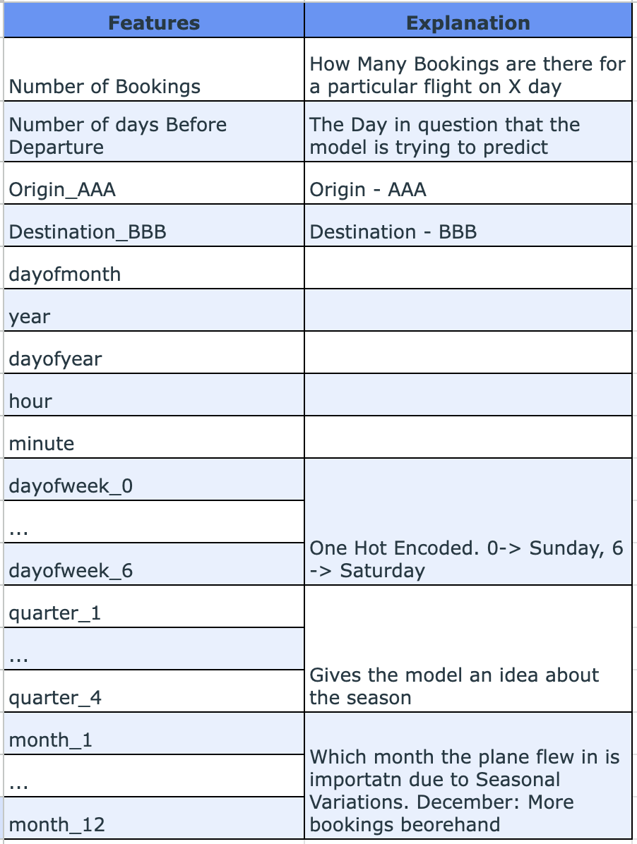
Features Used + Engineered
Important to note that the dates are dynamically adjusted
according to the 365 day schedule for each plane individually
To give it much more context about time

Slide 6
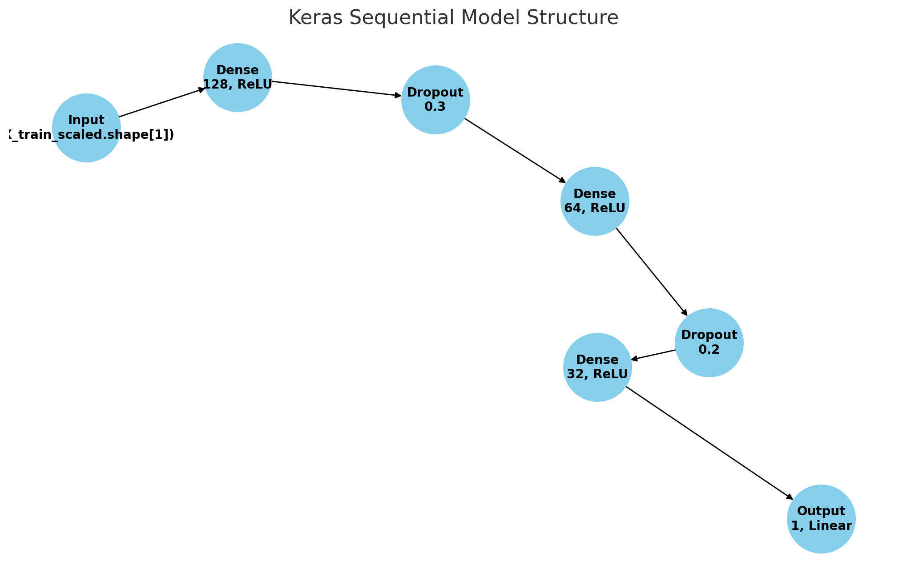
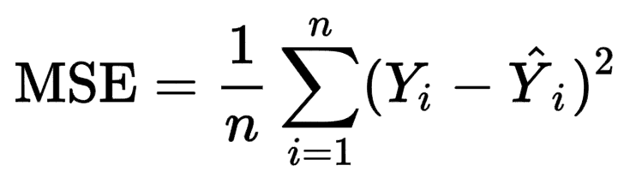
Model Used
Used a Fully Connected Neural Network.
Has multiple hidden layers and also Dropout to add regularization & robustness to the model.
Loss used:
Adam Optimizer used, with a learning rate of 0.001
Test Mean Absolute Error: 6.544564723968506

Slide 7
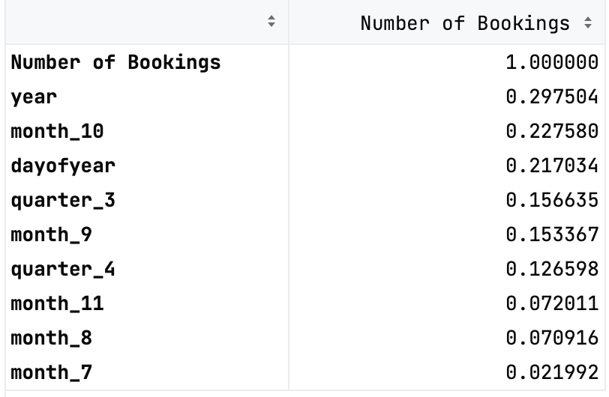
Co-relation Matrix (first 10 rows)

Slide 8

Model-1 [FCN] Prediction of Booking Curve Using Only the Flight Data

Slide 9
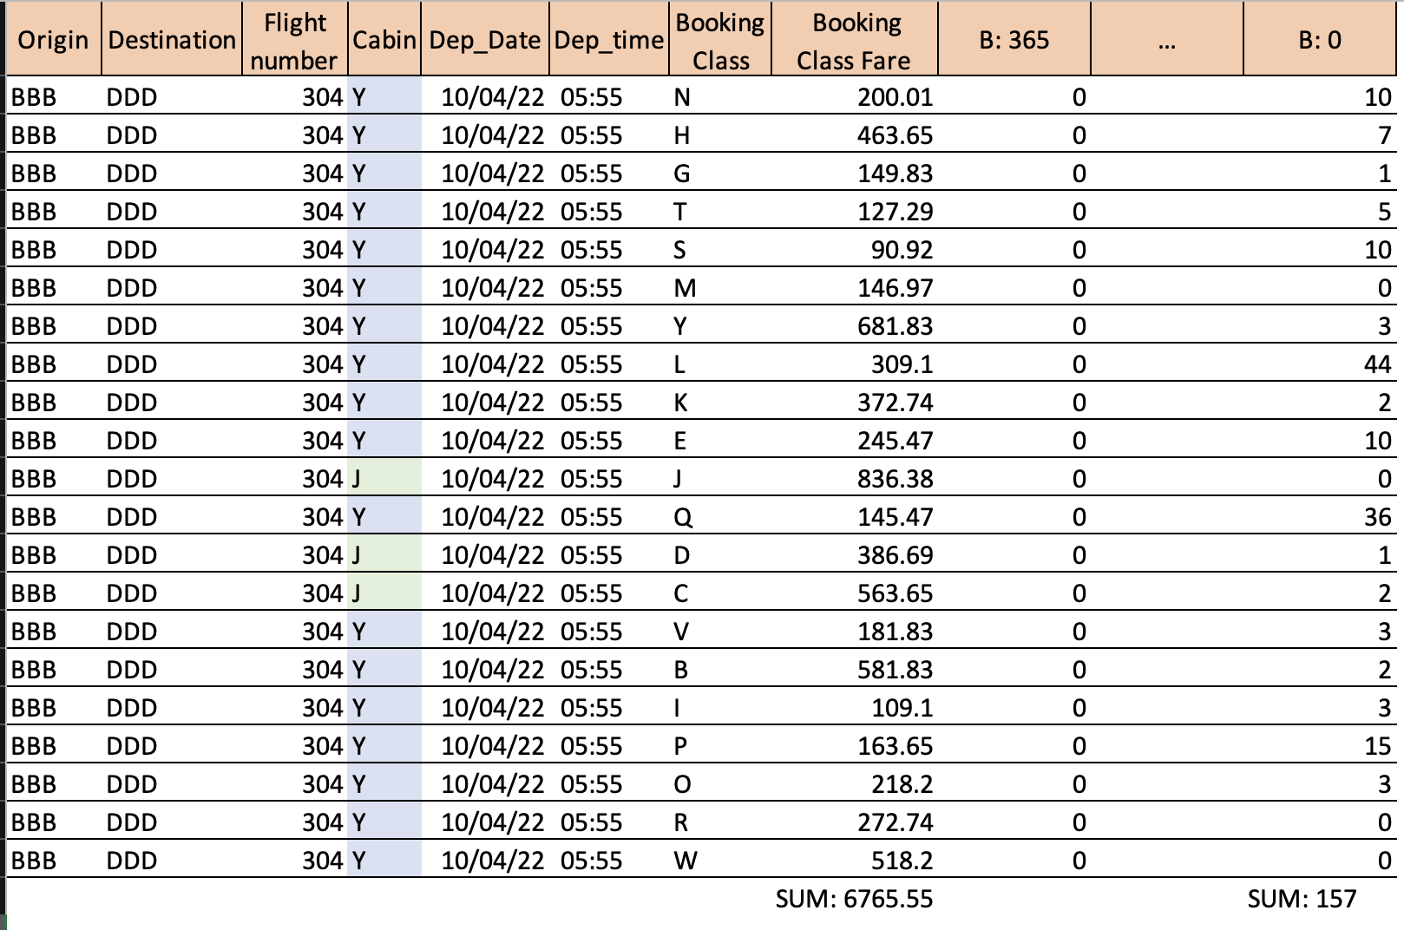
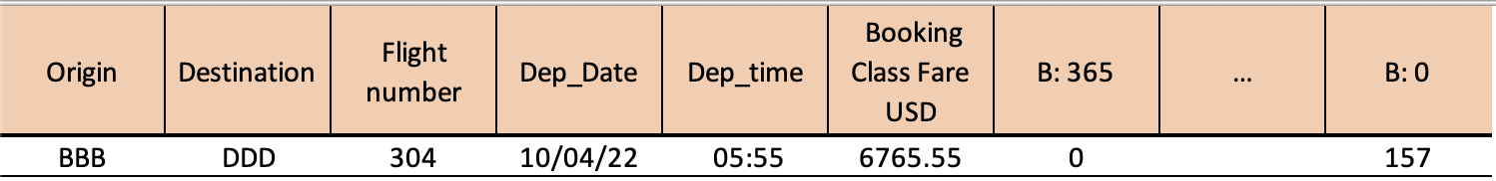
Data transformation
9635 such rows

Slide 10
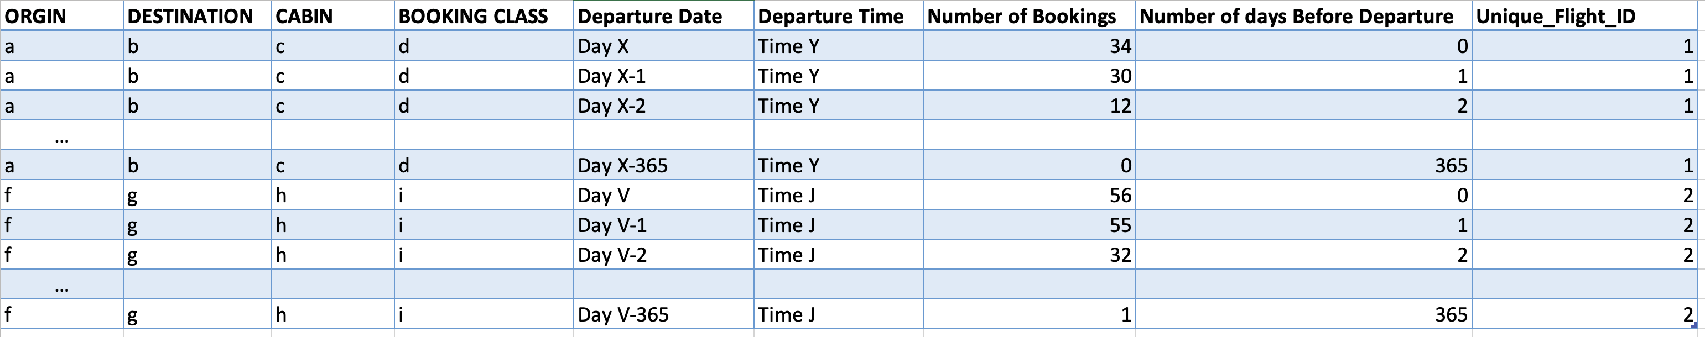
Transforming the dataset to long form from wide-form

Slide 11
EDA
Boxplot of the Month vs Number of Bookings in my sample of 1000 flights.

Slide 13
Model-2 [FCN] Prediction Using Booking Class [Y: Economy or J: Business]

Slide 14
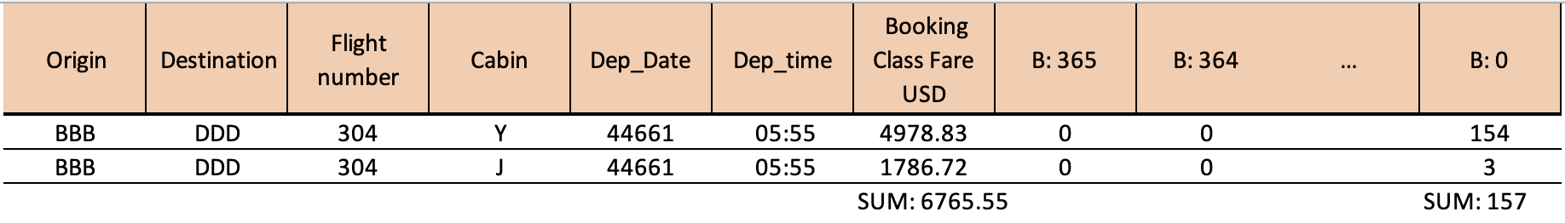
Transforming/Re-Formatting the data
18574 such rows

Slide 15
Transforming the dataset to long-form from wide-form
Similar “melting” or unpivoting of the set was conducted. Addition of Y and J col is the only change.

Slide 16
EDA
Economy
Business
Month of Booking vs Number of Bookings

Slide 17
Prediction Using Business Class
Flat curve.
Fewer updates in the Booking Number all year round.
Prediction curve for Business Class. Trained a Model specifically on the Subset of Business Class booking data
Used a fully connected dense neural network as the regressor.

Slide 18
Prediction Using Economy Class
Curvilinear curve.
Much more updates in the Booking Number all year round due to cheaper cost
Prediction curve for Economy Class. Trained a Model specifically on the Subset of Economy Class booking data
Used a fully connected dense neural network as the regressor.

Slide 19
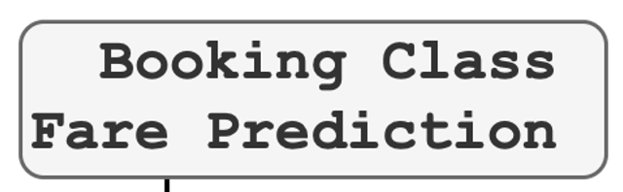

Slide 20
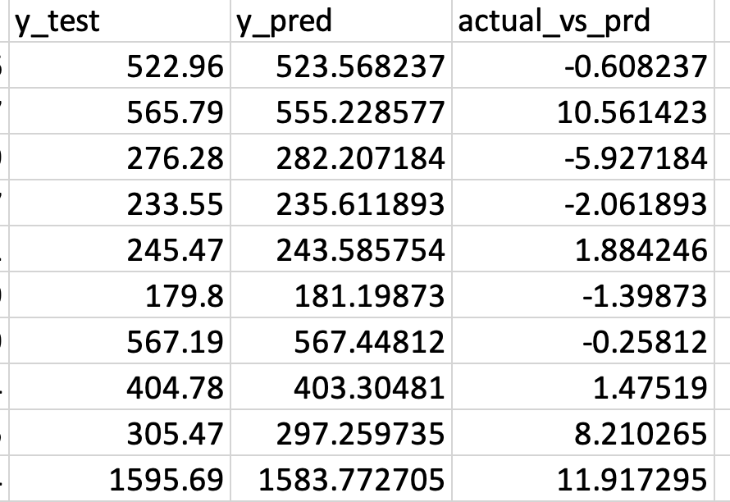

Slide 21
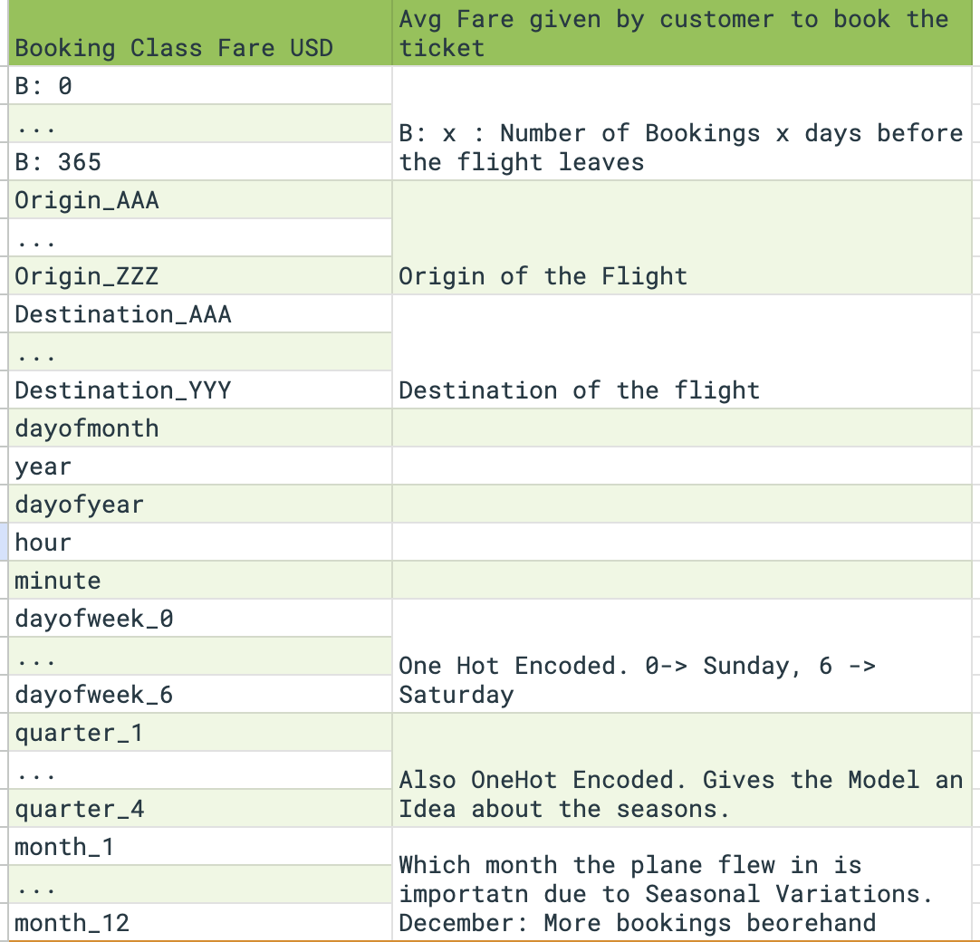
Features Used + Engineered

Slide 22
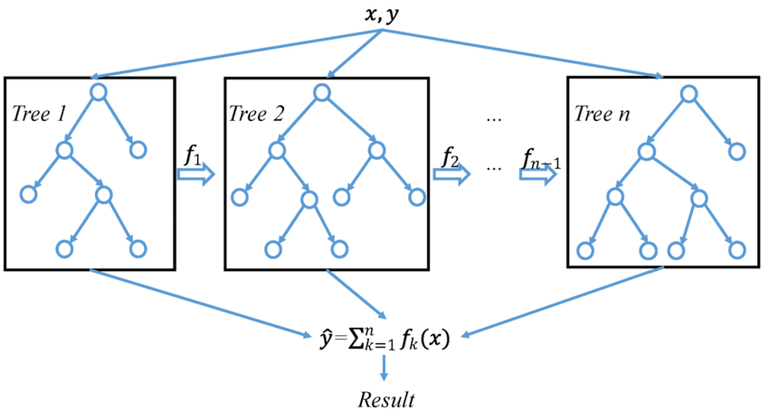
Model Used
Used XGBoost Regressor
Loss/Objective: reg:squarederror
n_estimators=100
learning_rate=0.1

Slide 23
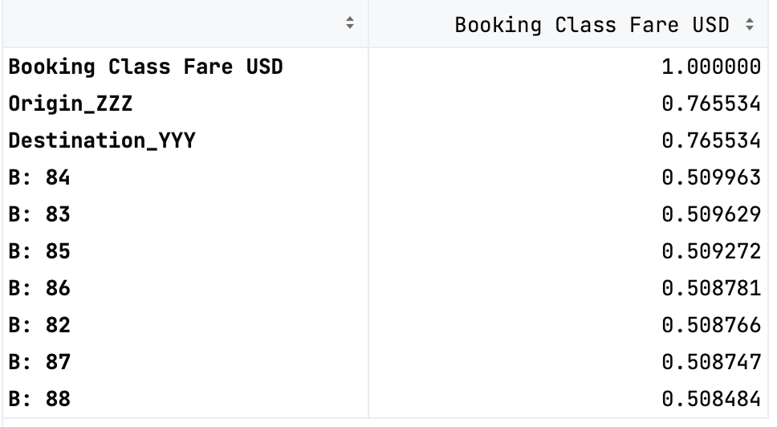
Correlation Matrix

Slide 24
Model-3 [XGBR] Prediction of “Booking Class Fare USD” using Only the Flight Data

Slide 25
Condensation/Transformation of Dataset
9635 such rows

Slide 26
Prediction Using Only the Flight Data: EDA
Day of Week vs Booking Class Fare
Month vs Booking Class Fare

Slide 27
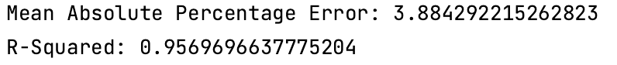
Prediction Using Only the Flight Data: EDA

Slide 28
Model-4 [XGBR] Predicts Booking Price Uses Y (Economy) & J (Business)

Slide 29
Condensation of the Data
18574 such rows

Slide 30
EDA
Business’ lack of volume when summed outputs a value that competes with Economy on Summation but does not surpass it.
Ecnomy’s sheer volume when summed outputs a greater value
Of Booking Class Fare

Slide 31
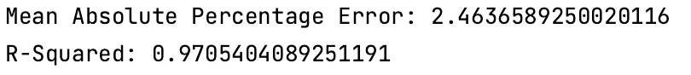
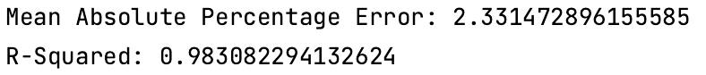
Prediction Using Booking Class [Y: Economy or J: Business]
Economy
Business
Models trained for Economy & Business perform accurately.

Slide 32
Model-3 [XGBR] Predicts Booking Price (by both cabin + booking class)

Slide 33
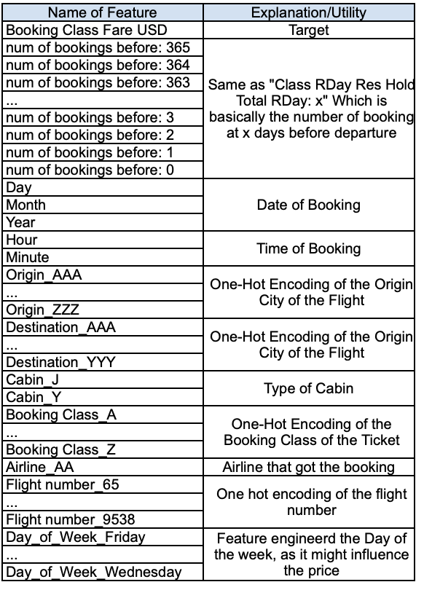
Input Features

Slide 34
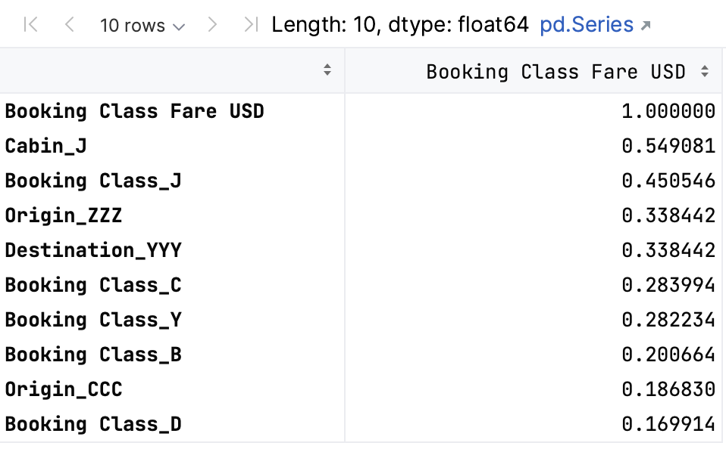
Correlation of the Features to the Output

Slide 36

Thank you
In conclusion I built several models to predict/model the Booking Price (Cost) and the Number of Bookings
(Demand) as asked in the problem statement.

Slide 37
Random Flight: Model Prediction vs Ground Truths for a Month

Slide 38
Random Flight: Model Prediction vs Ground Truths for a Quarter

